Slide 1

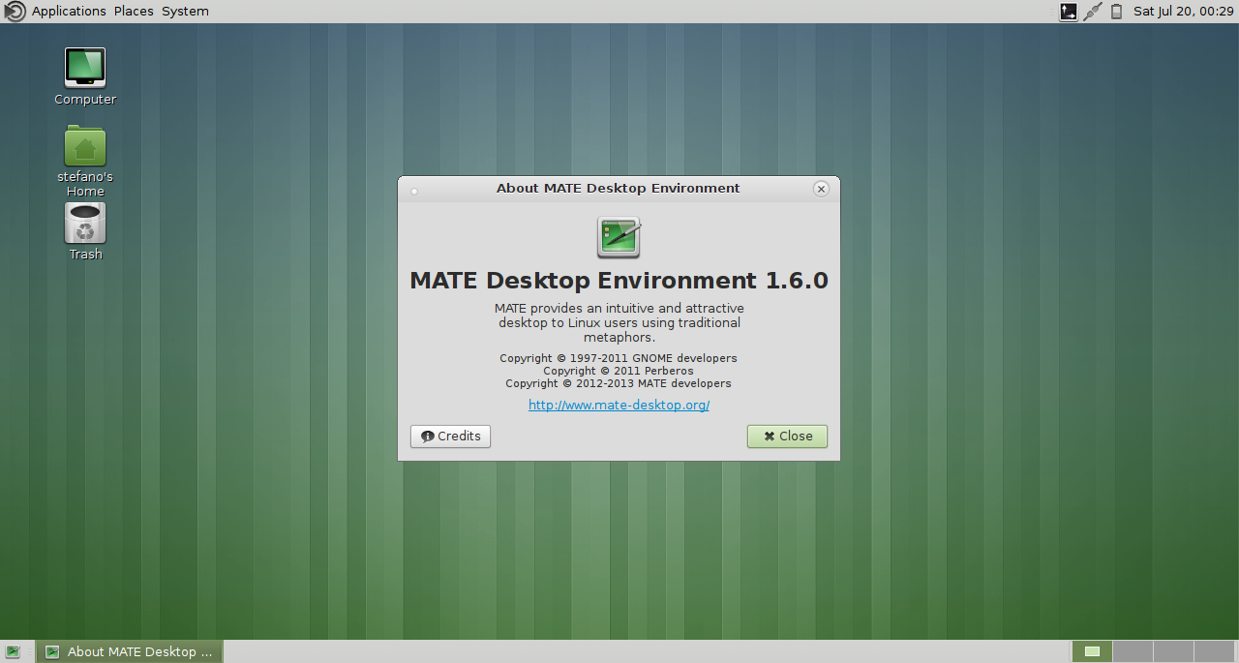

MATE Desktop
The continuation of GNOME 2
Stefano Karapetsas
openSUSE Conference 2013

Slide 2
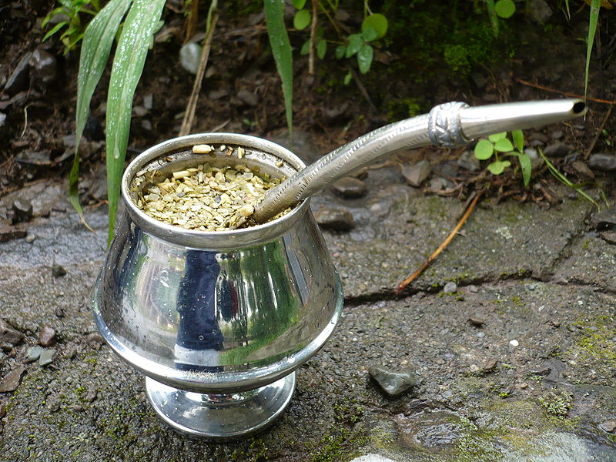
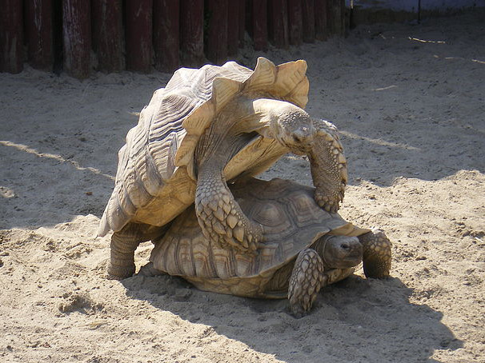


Pronunciation
MATE
mate

Slide 3
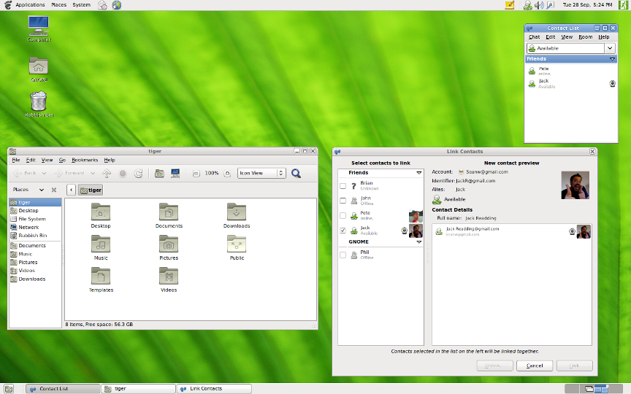
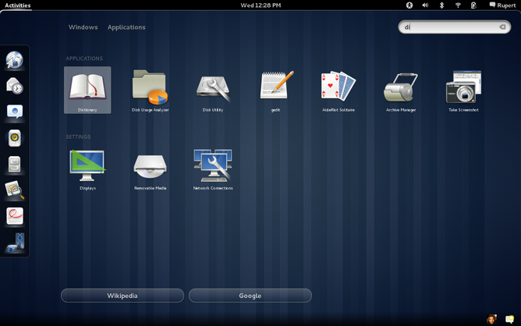
History
GNOME 2.32
September 2010
GNOME 3.0
April 2011

Slide 4

GNOME 2 Fork
Perberos, in a thread on Archlinux forum
(June 2011):
Hello everyone.
I've made a GNOME2 fork.
I've called it "MATE".
MATE Desktop Environment, a non-intuitive and
Unattractive Desktop for users, using traditional
computing desktop metaphor.

Slide 5
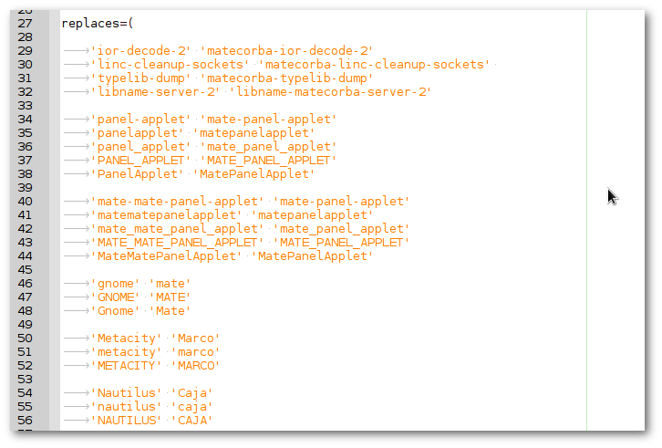
Migrate script

Slide 6
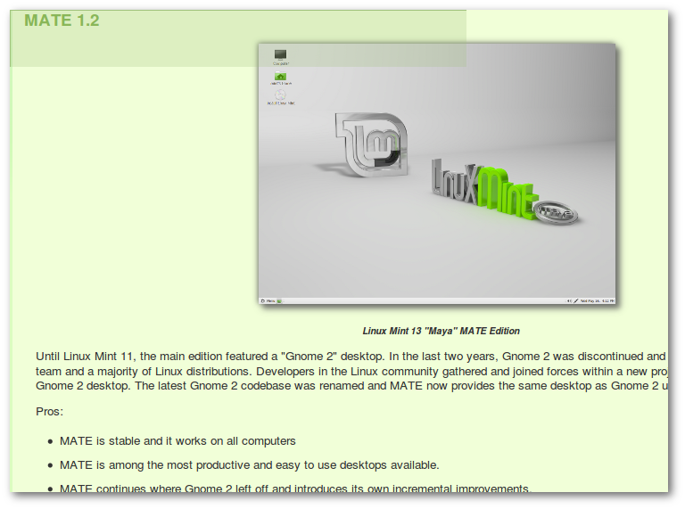
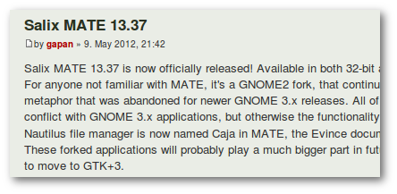
Distributions
First distributions started to include MATE
in their repositories, and also MATE editions

Slide 7
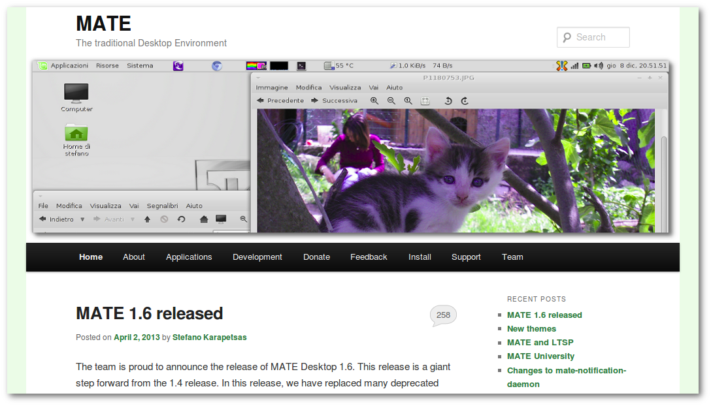
A new community
Website
http://www.mate-desktop.org
Wiki
Forum
IRC
#mate, #mate-dev, #opensuse-mate, …
Mailing lists
http://ml.mate-desktop.org/
Development on GitHub
https://github.com/mate-desktop

Slide 8
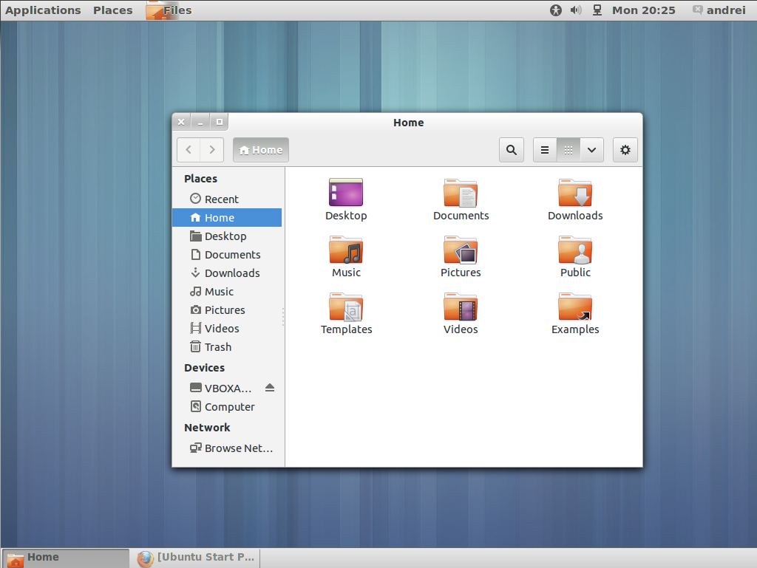
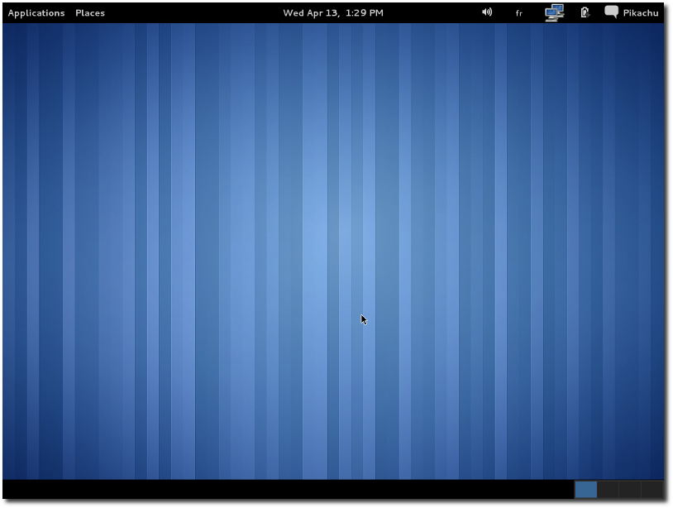
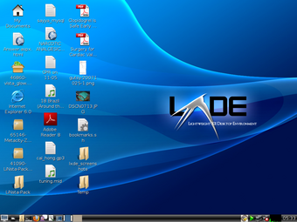
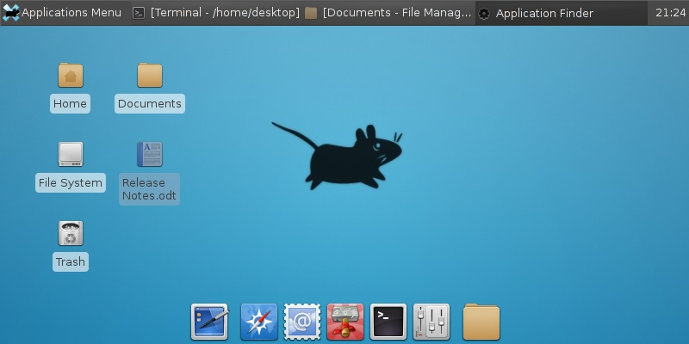
Why MATE?
GNOME 3
Classic
Flashback
LXDE
XFCE

Slide 9
1.6 release
We consider it like our idea of GNOME 2.34
Obsolete technology removed
(gconf, bonobo, gnomevfs forks)
Initial systemd support
A lot of bugfixes
A lot of small new features
Themes with GTK3 support
“MATE 1.6 is the result of 8 months of intense
development and contains 1800 contributions by 39
people, and more than 150 translators”

Slide 10
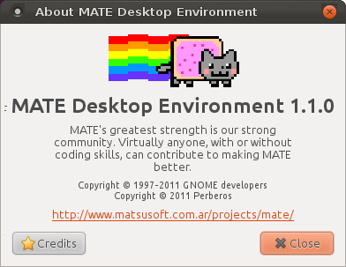
New features
Nyan Cat
in about window

Slide 11
New features
Option to center new windows
New panel arguments (--reset, --run-dialog)
Close windows with middle click on button
New themes for notifications
MPRIS2 support
Support for compiz and metacity
...

Slide 12
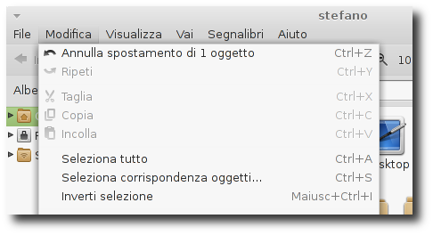
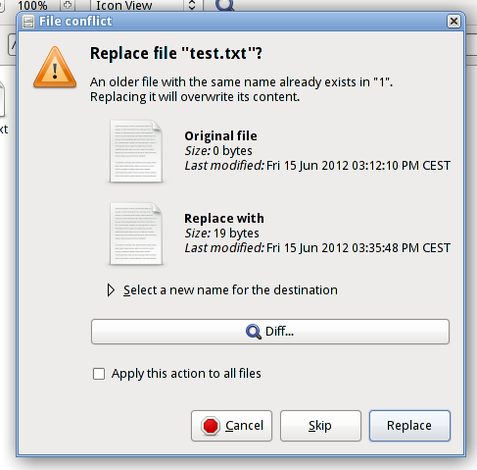
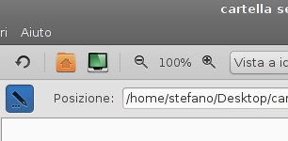
Caja new features
Undo/Redo
Diff button when
overwrite text files
Edit location
toggle button

Slide 13
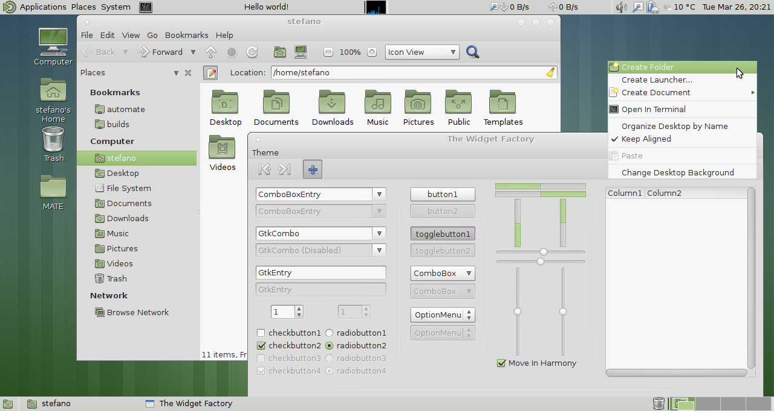
New themes
Menta

Slide 14
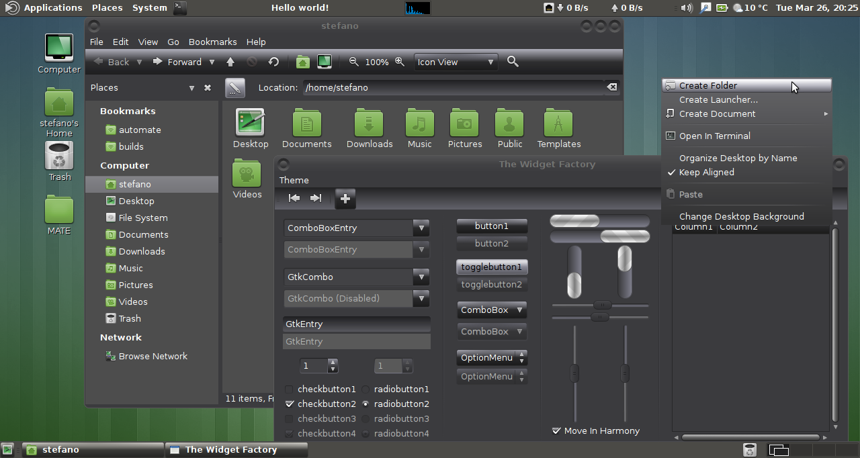
New themes
BlackMATE

Slide 15
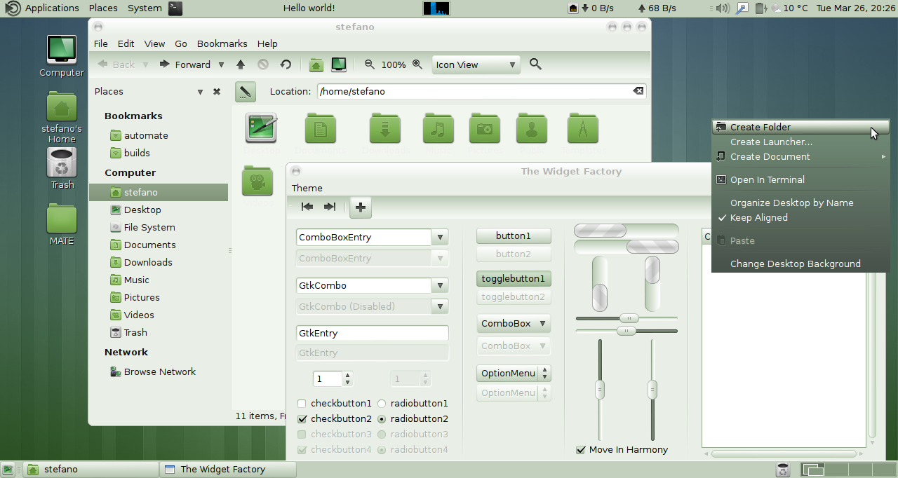
New themes
GreenLaguna

Slide 16
MATE 1.6 success
Included in some big distributions
Fedora, Linux Mint, Sabayon, Salix
Packages available for many distributions
Archlinux, Debian, Gentoo, openSUSE, Slackware, Ubuntu
A growing community
~70 people always on #mate
~10 active contributors
1100+ members and 5000+ posts on official forum
1400+ comments on website
A GSOC student under Fedora project
A lot of donations

Slide 17
MATE Project goals
Traditional Desktop Metaphor
The MATE Desktop Project is dedicated to
keeping alive the traditional GNOME 2 desktop
metaphor.
Many users liked this desktop, and found it
simple, configurable, and comfortable to use.
Our goal is to continue the development of this
desktop environment, adding new features,
fixing bugs, and improving the software as
support libraries and other dependent software
improves and changes.

Slide 18
MATE Project goals
Alternative for Lower End Hardware
We recognize that the MATE Desktop Environment
may be an attractive option for people running
non-compositing hardware, such as older hardware,
or thin client technology.
While the MATE Desktop Environment wants to
provide a first-rate user experience for compositing
capable machines, we are committed to maintaining
the option of running the MATE Desktop Environment
on lower-end hardware.

Slide 19
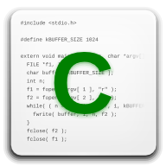
MATE University
https://github.com/mate-desktop/mate-university
Targeted at all levels of developers
Learn how to develop:
Panel applets
Caja (file manager) extensions
Pluma (text editor)
EOM (image viewer) plugins
etc.

Slide 20
Future of MATE
http://wiki.mate-desktop.org/roadmap
Support GTK3 and Wayland
Complete support for systemd
Support GStreamer 1.0
Support AccountsService
Window snapping in window manager
Plugin system for file manager
Remove useless forks and use GNOME
equivalent (gnome-keyring, gweather,
yelp-tools, libwnck, etc.)

Slide 21

MATE in openSUSE
http://en.opensuse.org/Portal:MATE
Packages available for:
12.1, 12.2, 12.3 & Tumbleweed
Give a choice to users
Give to users their old
favorite and traditional
Desktop Environment
Alternative for old hardware

Slide 22
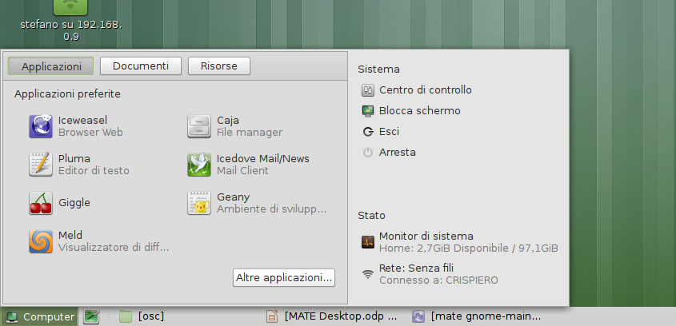
GNOME Main Menu

Slide 23
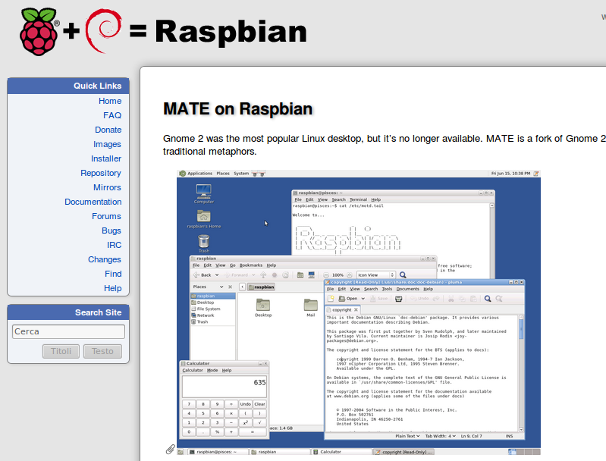
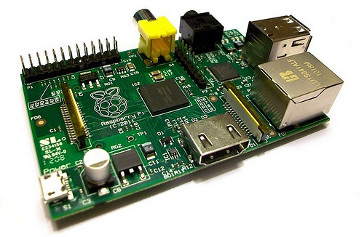
MATE for Raspberry

Slide 24

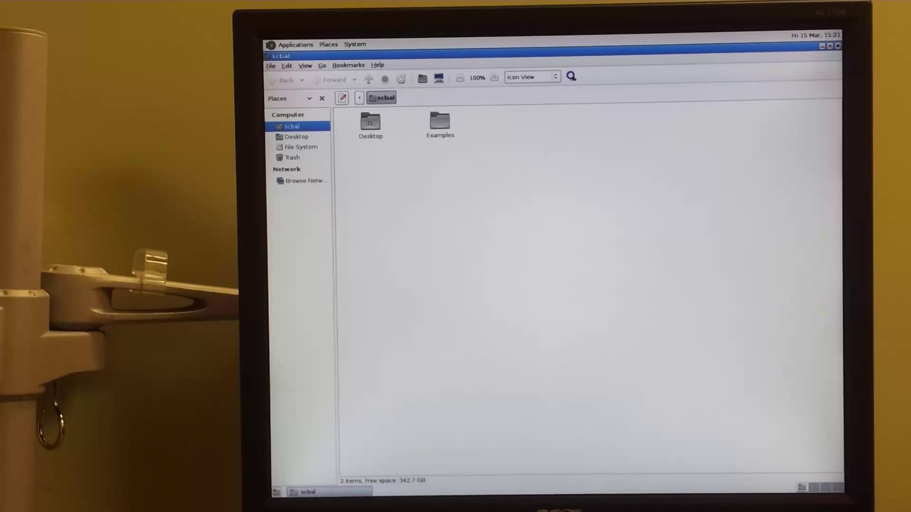
MATE + LTSP

Slide 25
Contribute
#mate on irc.freenode.net
https://github.com/mate-desktop
mate-dev@ml.mate-desktop.org
http://www.mate-desktop.org

Slide 26
Thank you
Questions?

